Slide 1
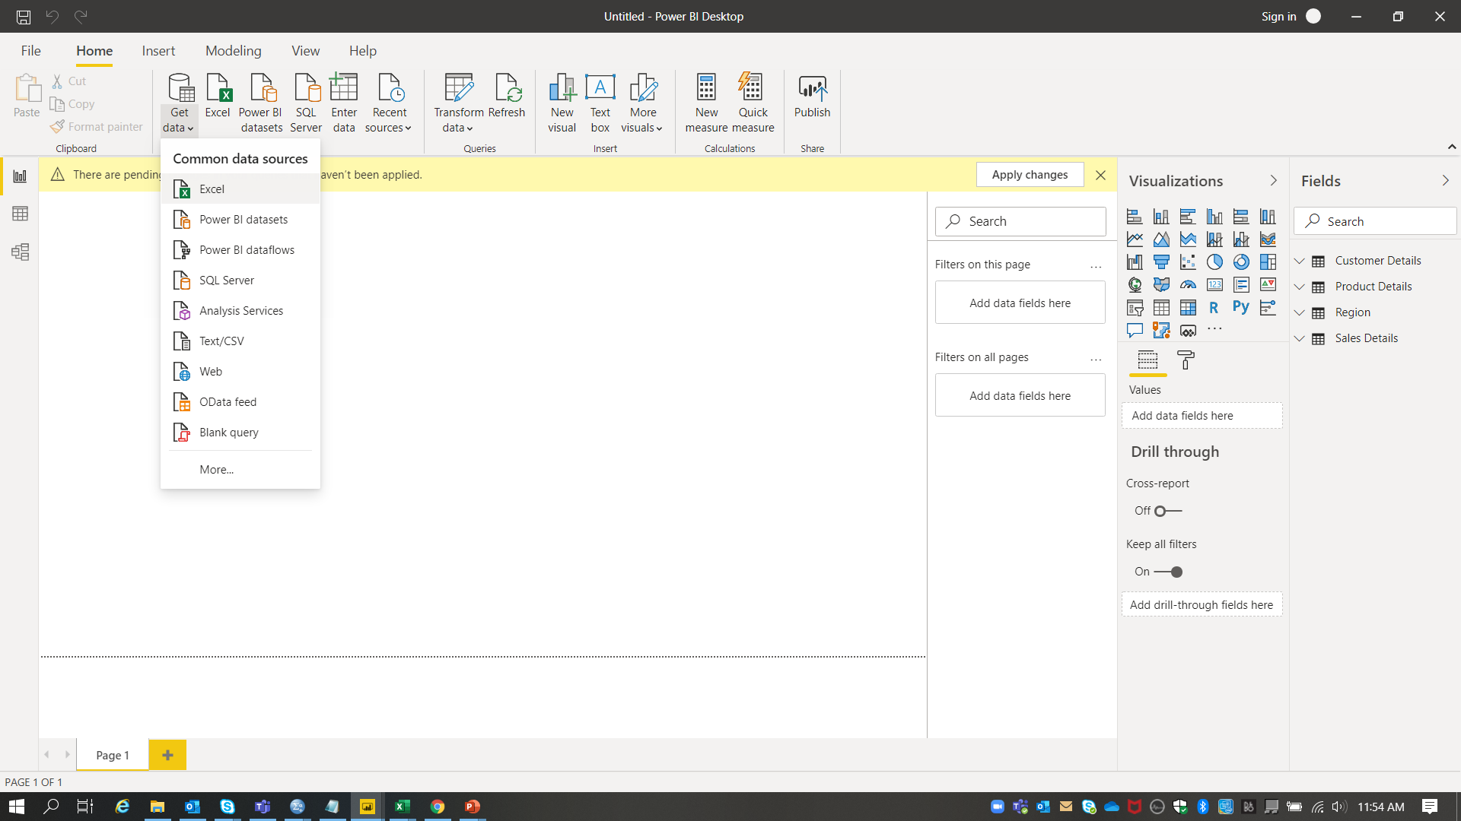
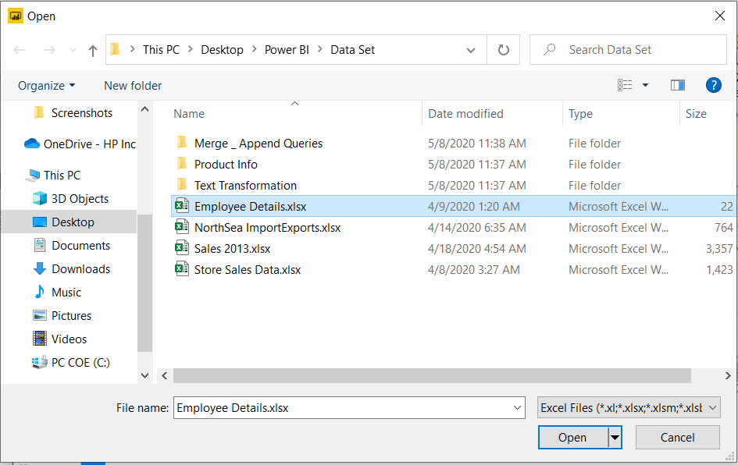
Connect to the Employee Data and do the following: -
Steps to connect to the data.
Home page -> Get Data -> Excel -> Select the required file -> Open

Slide 2
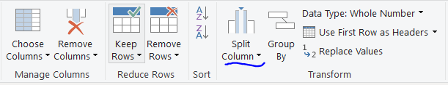
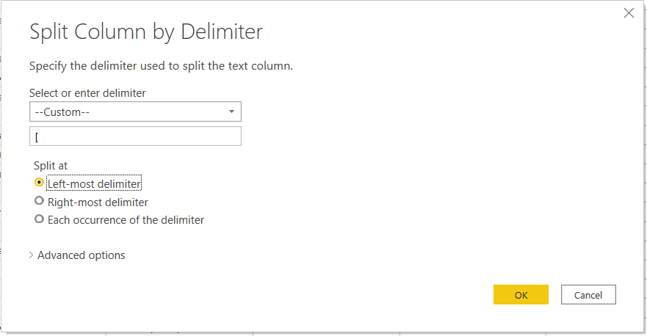
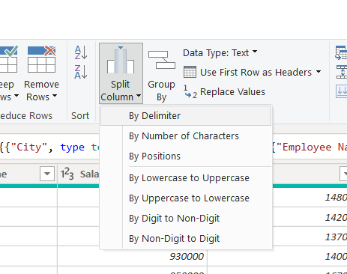
Split the column CITY and separate the code associate with each city like - Allahabad[AL2] should be only Allahabad and [A2] will be separate.
Steps :
Select the column ->Home -> Split Column -> By Delimiter -> Enter ‘[‘ & select ‘Left-most delimiter -> OK

Slide 3
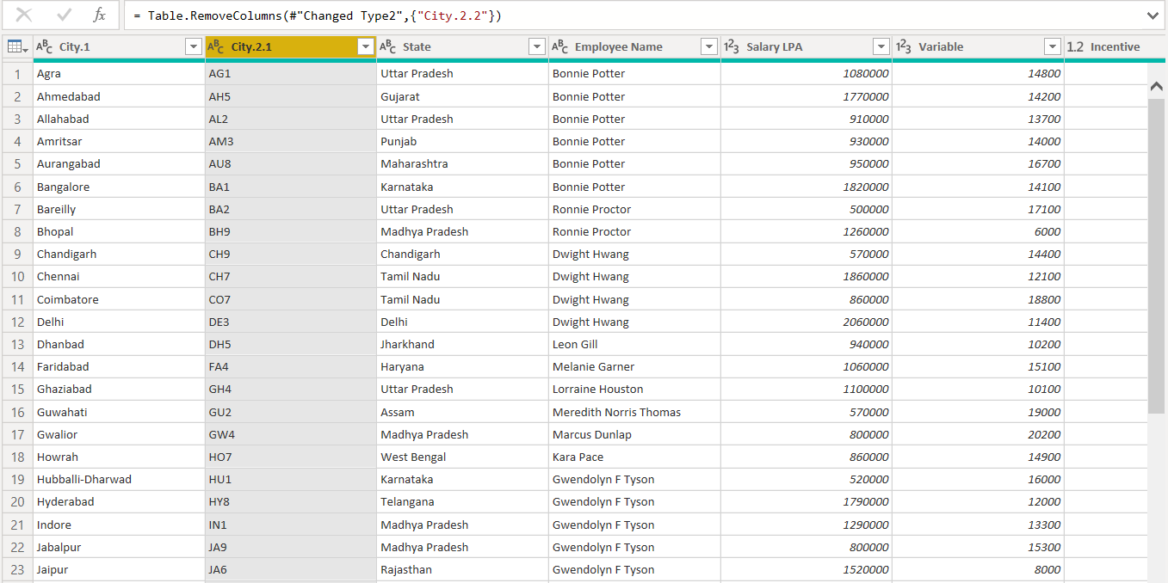
Split the column CITY and separate the code associate with each city like - Allahabad[AL2] should be only Allahabad and [A2] will be separate.
Output :

Slide 4
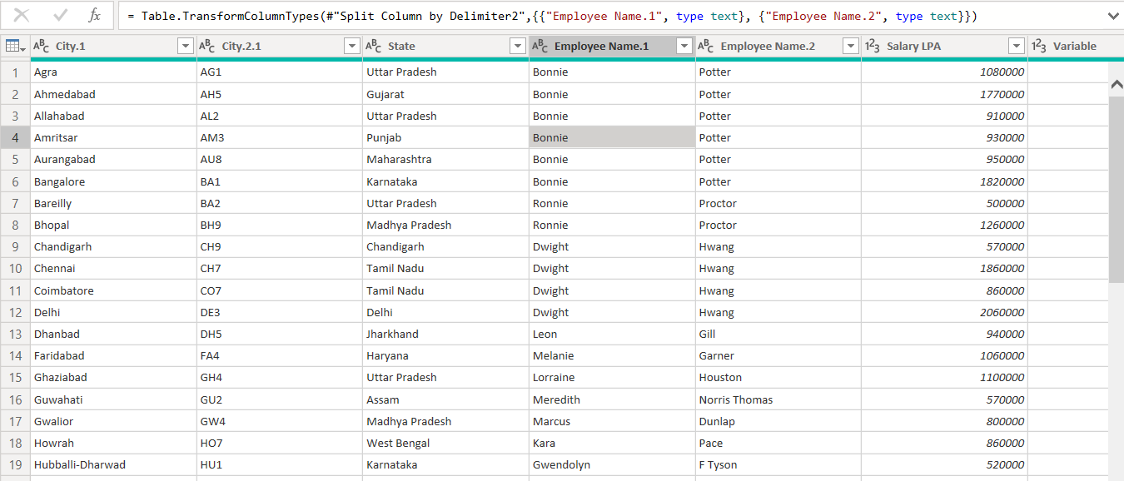
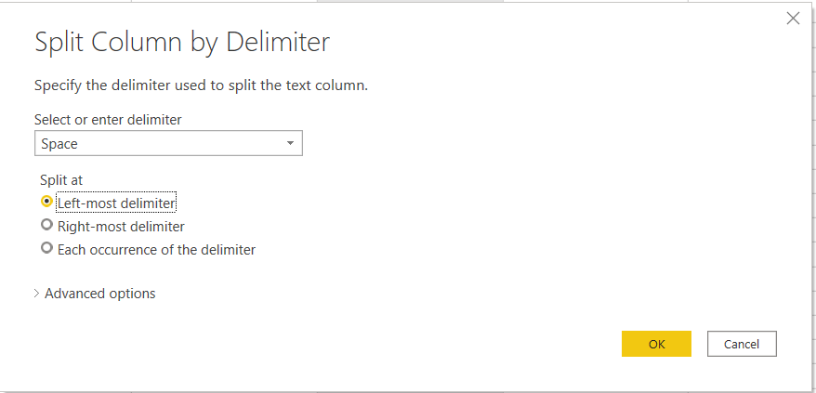
2. Extract the first name from EMPLOYEE NAME column and transform the column
Steps :
Select the column ->Home -> Split Column -> By Delimiter -> Enter ‘space‘ & select ‘Left-most delimiter -> OK
Out put

Slide 5
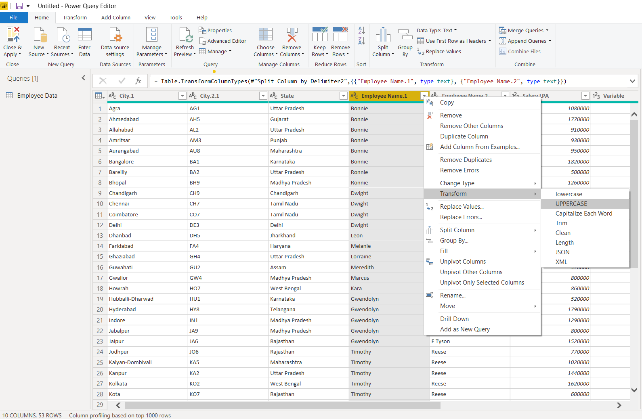
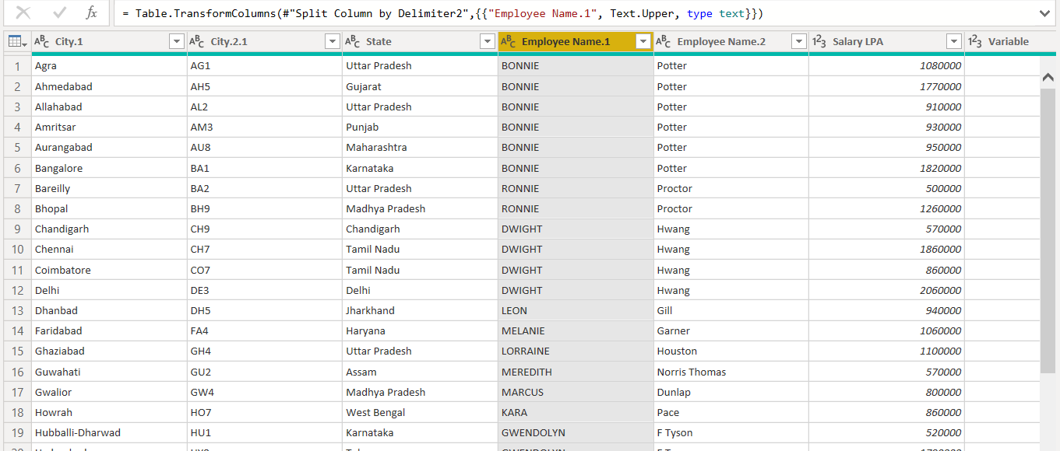
2. Extract the first name from EMPLOYEE NAME column and transform the column
Steps :
Select the column -> Right click -> Transform -> UPPERCASE
Out put

Slide 6
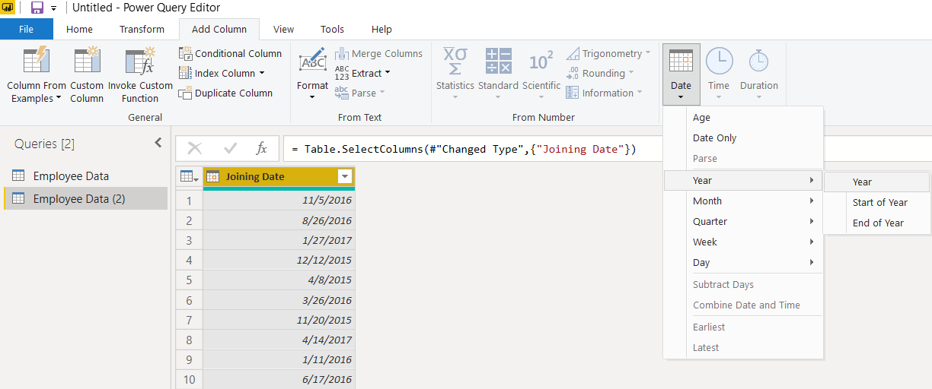
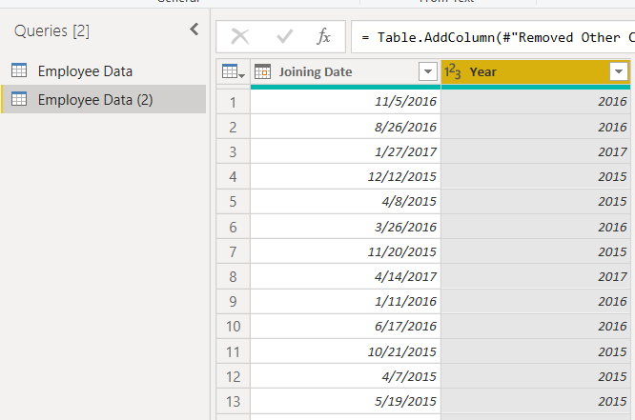
3. Using the JOINING DATE column extract the Year and no. of days for that month
Steps for extracting the date :
Select the date column -> Add column -> Date -> Year -> Year
Out put

Slide 7
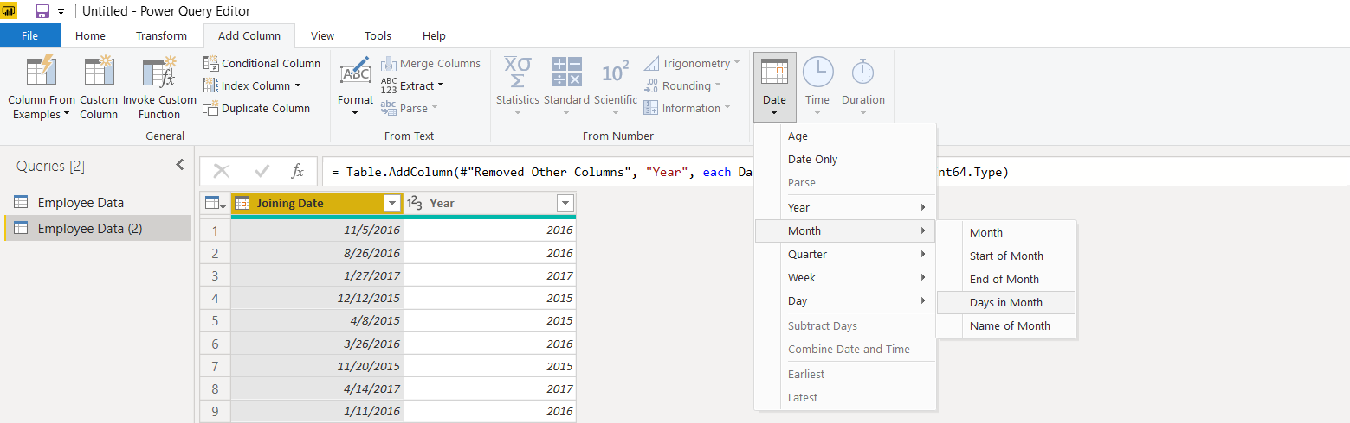
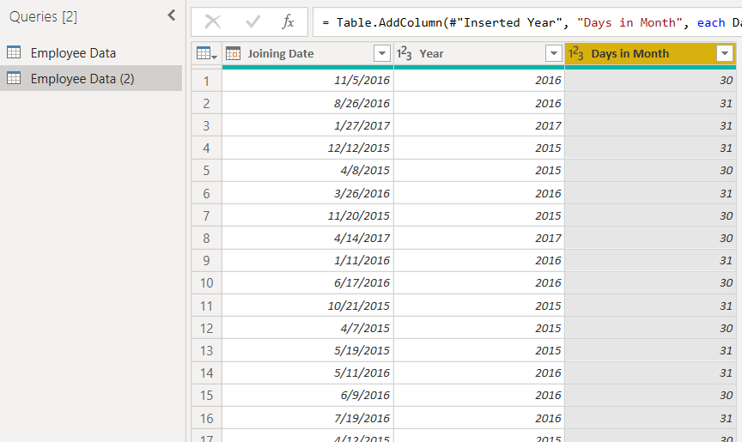
3. Using the JOINING DATE column extract the Year and no. of days for that month
Steps for extracting the number of days for that month :
Select the date column -> Add column -> Date -> Month -> Dates in Month
Out put

Slide 8
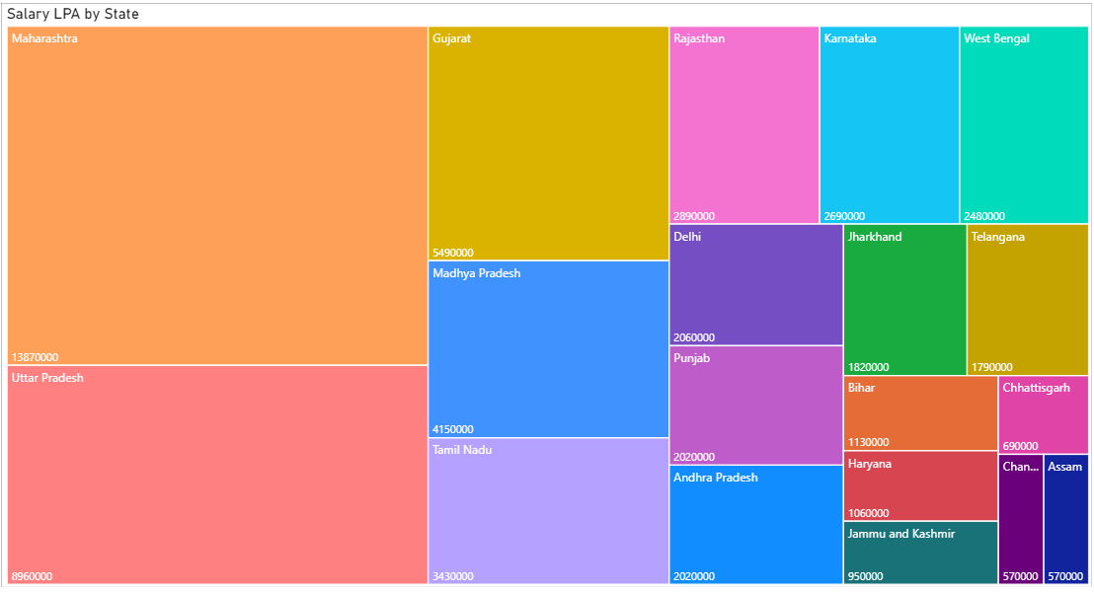
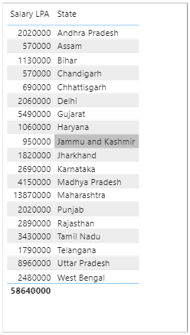
4. Create a visual of your choice and show the how much salary has been paid to each state and which state has lowest payout.
Steps :
For Tree Map -Visualize -> Tree map -> Drag ‘State’ to group & ‘Salary’ to Values
For Data Table - Visualize -> Table -> Drag ‘State’ & ‘Salary’ to Values
Assam & Chhattisgarh has the employees with lowest salary – 570000.

